Slide 1
Blockchain Fundamentals (Contd..)
Hash Pointer:
A Cryptographic Hash Pointer is a pointer to a location where
    some information is stored.
    hash of the information is stored.
With the hash pointer, we can
    Retrieve the information.
    Check that the information has not been modified (by computing the message digest and then matching the digest with the stored hash value).

Slide 2
Blockchain Fundamentals (Contd..)
Simplified look of the Hash Pointer:
H(DATA)
DATA
Hash Pointer

Slide 3
Blockchain Fundamentals (Contd..)
Hashchain:
H(D^{(i-1)})
H(D^{(i)})
H(D^{(i+1)})
D^{(i)}
D^{(i+1)}
D^{(i+2)}
Can be used to detect whether data is tampered or not?

Slide 4

Blockchain Fundamentals (Contd..)
Merkle Tree:
It is also known as hash tree.
Every leaf node is labelled with the hash of a data block.
Every non-leaf node is labelled with the cryptographic hash of the labels of its child nodes
Root Hash
H_{root}=Hash(H₀+H₁)
L₁ Hash
H₀= Hash(H₀₀+H₀₁)
L₁ Hash
H₁=Hash(H₁₀+H₁₁)
L₂ Hash
H₀₀=Hash(D₁)
L₂ Hash
H₀₁=Hash(D₂)
L₂ Hash
H₁₀=Hash(D₃)
L₂ Hash
H₁₁=Hash(D₄)
D1
D2
D3
D4

Slide 5
Blockchain Fundamentals (Contd..)
Digital Signature:
A digital code, which can be included with an electronically transmitted document to verify
  The content of the document is authenticated.
  The identity of the sender.
  Prevent non-repudiation – sender will not be able to deny about the origin of the document

Slide 6


Blockchain Fundamentals (Contd..)
Digital Signature using Public Key Cryptography:
Sign the message using the Private key.
Verify the signature using the Public key.
Sign the message with alice private key
M’ = E(M,K)
Verify the message with alice public key
M = E(M’ , K’)
M,M’
K = private key
K’ = public key
Alice
Bob

Slide 7
Blockchain Fundamentals (Contd..)
Digital Signature in blockchain:
Used to validate the origin of a transaction
Prevent non-repudiation
    Alice can not deny her own transactions.
    No one else can claim Alice’s transaction as his/her own transaction
Bitcoin uses Elliptic Curve Digital Signature Algorithm (ECDSA).

Slide 8
Structure of a Block in the blockchain:
A block is a container data structure that contains a series of transactions.
Two components:
    Block header
    Block body

Slide 9
Structure of a Block in the blockchain (Contd..)
Block header
Block header consists :
Previous block hash
Mining statistics used to construct the block (Nonce, Difficulty-target, Time-stamp)
Merkle tree root
A=H(ph||MT||Nonce||Timestamp)
H0
H1 = Hash(H0)
H2 = Hash(H1)
H3 = Hash(H2)
Keyword:
Previous block hash is used to construct the blockchain tamper-proof.
H4 = Hash(H3)

Slide 10
Structure of a Block in the blockchain (Contd..)
Block body
Block body consists of list of transaction.
The merkle tree is created based on the transaction and the merkle root is stored in the block header for further computation.

Slide 11
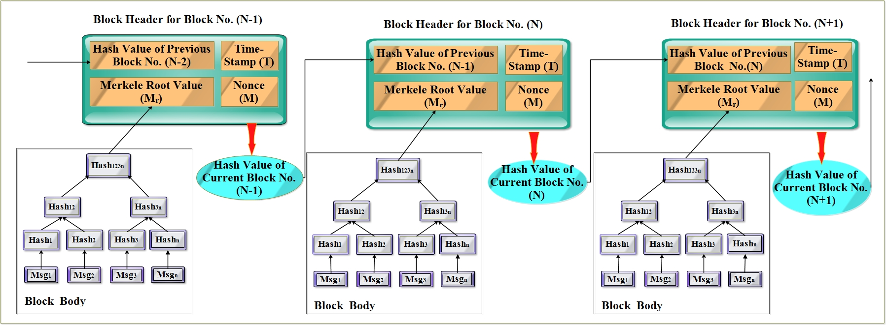
Block structure and merkle tree:

Slide 12
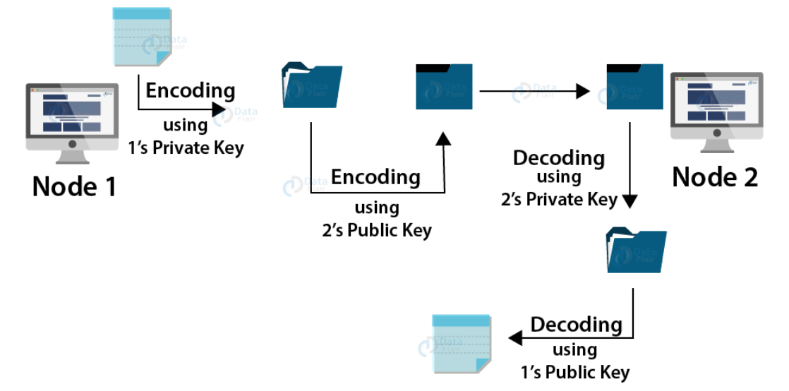
Blockchain Network Understanding:
How does transaction take place between two nodes in a network?
A blockchain network consists of multiple nodes that have a point-to-point or peer-to-peer connection. Each node in a blockchain network is capable of doing transactions, verifying other transactions and doing proof-of-work. Let us consider a scenario where there are 500 nodes spread across the globe making a blockchain network. Node A (from USA) wants to send some information to node B (in London). Both the nodes A and B will have their set of private and public keys. Before A sends the information packet to B, it will encrypt the message first with A’s private key and then again with B’s public key. This is to ensure that the message goes only to B and B can confirm that A has sent this message out of so many nodes.
On the receiving end, B will have to decrypt the message first using B’s private key and then with A’s public key. Also, a request of verification of this transaction between A and B is sent to all the 498 participant nodes in the network. As soon as all the nodes verify a transaction, the system adds it in a new block with other transactions.

Slide 13

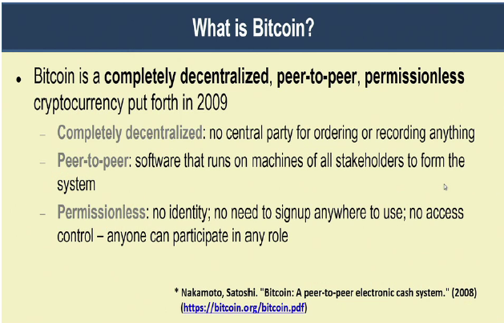
Bitcoin Blockchain:
Bitcoin is a completely decentralized, peer-to-peer, permissionless cryptocurrency put forth in 2009.
Keywords:
Completely decentralized
Peer-to-peer
Permissionless

Slide 14




Bitcoin Blockchain:
Remember the blockchain concept ?
A = ₹100
₹ 50
A = ₹100
A -> B ₹50
A -> B ₹50
B -> J ₹30
Bob
B -> J ₹30
Alice
₹ 100
₹ 30
A = ₹100
Note: A block may contain multiple transactions
A = ₹100
A -> B ₹50
A -> B ₹50
B -> J ₹30
Eve
Jane
B -> J ₹30

Slide 15
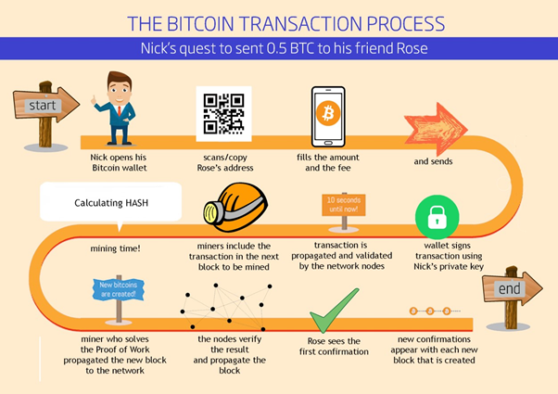
Bitcoin Transaction Process

Slide 16
Blockchain The bitcoin transaction life cycle (Steps):
Alice opens her Bitcoin Wallet.
Alice provides the address of Bob and the amount to transfer, and sends.
The wallet constructs the transactions, sign using Alice’s private key, and broadcasts it to the network
The network nodes validate the transactions based on the existing Blockchain, and propagate the transaction to the miners.

Slide 17
Blockchain The bitcoin transaction life cycle (Steps) (Contd..):
The miners include the transaction to the next block to be mined.
The miners collect all the transactions for the a time duration, say for 10 Minutes.
Miners construct a new block and tries to connect it with the existing blockchain, through a cryptographic hash computation. ( The Mining Procedure- Proof-of-work)
Once the mining is over and the hash is obtained, the block is included in the existing blockchain.

Slide 18
Blockchain The bitcoin transaction life cycle (Steps) (Contd..):
The updated blockchain is propagated in the network.
All the remaining nodes validates the new block. Whether targeted hash value is achieved or not?
Bob opens his Bitcoin Wallet and refreshes, the blockchain gets updated.
The transaction reflects at Bob’s wallet.

Slide 19
The Mining Procedure
Join the network and listen for transactions.
Validate the proposed transactions.
Collect transactions for a predefined time (10 minutes in bitcoin) and construct a new block.
Broadcast a new block for validating the new block.
Other miners validate the new block.
After the successful validation of new block, it is added in the blockchain.

Slide 20
The Mining Procedure
Mining
The mechanism to generate the hash of new block.
The mechanism needs to be complicated enough, to make the blockchain tamper proof.
Bitcoin Mining: H_{k} = Hash(H_{k-1} || T || Nonce)
  Find the nonce such that H_{k} has certain predefined complexity (number of zeros at the prefix)

Slide 21
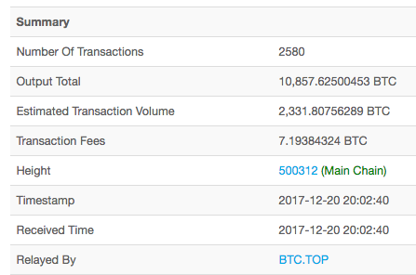
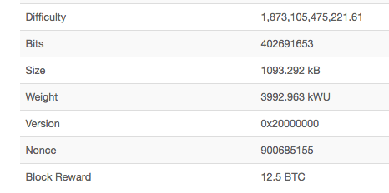
Bitcoin block header :

Slide 22
Bitcoin block header (Contd..):
Difficulty
A measure of how difficult it is to fond a hash below a given target.
The difficulty changes for every 2016 blocks.
Desired rate – one block each 10 minutes.
Two weeks to generate 2016 blocks.
The change in difficulty is in proportion to the amount of time over or under two weeks the previous 2016 blocks took to find.

Slide 23
Bitcoin block header (Contd..):
Setting the Difficulty
Current_difficulty = Previous_difficulty * (2 weeks in milliseconds)/(milliseconds
to mine last 2016 blocks).

Slide 24
Bitcoin block header (Contd..):
Example:
Suppose at a given instance, the difficulty set by the BitCoin network is 63, with the last 2016 blocks mined in 10 days. What will be the next computed value of the difficulty [use ceiling to round off to the next integer]?
Solution: Current_difficulty = 88.2
=89

Slide 25
Bitcoin block header (Contd..):
Question:
Suppose at a given instance the difficulty set by the BitCoin network is 56, with the last 2016 blocks mined in 11 days. What will be the next computed value of the difficulty [use ceiling to round off to the next integer]?
Solution: Current_difficulty = 72

Slide 26
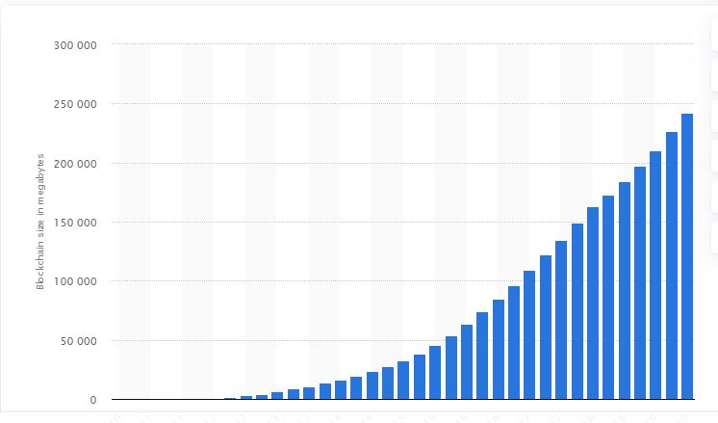
Bitcoin block header :
Current height of blockchain: 611104 (2020-01-03 19:06).
Size of the Bitcoin blockchain from 2010 to 2019, by quarter(in megabytes):

Slide 27
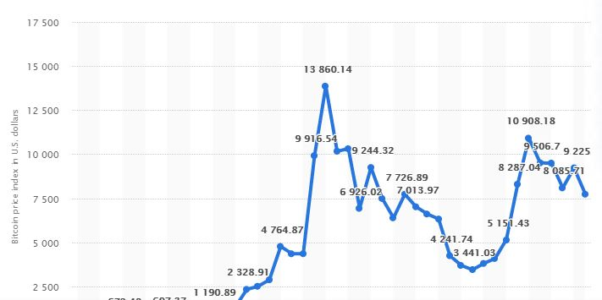
Bitcoin Blockchain:
Bitcoin price index from January 2016 to November 2019(in U.S. dollars):

